Slide 1
Fake News Detection Using Deep Learning
Shahida Akhtar
23F-8011
MSCS

Slide 2
Introduction
The project is a Fake News Detection and Classification web application that uses a combination of Long Short-Term Memory (LSTM) and Dense neural networks to classify text as either fake or real news.
Key Features:
Text Preprocessing
LSTM Model
Dense Neural Network
Web Application

Slide 3
Why Fake News Detection?
Misinformation Impact:
Misleading individuals and leading to wrong decisions.
Creating confusion and potential harm.
Social Consequences:
Generating social unrest and influencing public opinion.
Inciting violence and disrupting social harmony.
Economic Implications:
Impacting financial markets, businesses, and economies.
Preserving the integrity of financial information and market stability.

Slide 4
Political Influence:
Manipulating public perception and influencing elections.
Undermining democratic processes and decision-making.
Personal Well-being:
Emotionally affecting individuals with stress and anxiety.
Protecting individuals from psychological harm caused by false information.

Slide 5
Project Overview
Text-based Classification:
Allows users to input text and classify it as either fake or real news.
Leverages machine learning models to make the classification.
LSTM-based Feature Extraction:
Utilizes a pre-trained Long Short-Term Memory (LSTM) model to extract relevant features from the input text.
The LSTM model is trained on a dataset of fake and real news articles.
Dense Neural Network Classification:
Combines the LSTM-extracted features with the input text.
Passes the combined features through a Dense neural network for classification.
The Dense network outputs a probability score indicating the likelihood of the text being fake or real news.

Slide 6
Technologies Used:
Python
Numpy
Pandas
Scikit-learn
LSTM Model
Dense Neural Network
Flask

Slide 7
Architecture Diagram
LSTM
Input
Preprocessing
Feature Extraction
One Hot Label Encoding
Classification
Concatenation of Features with input data
Dense Neural Network

Slide 8
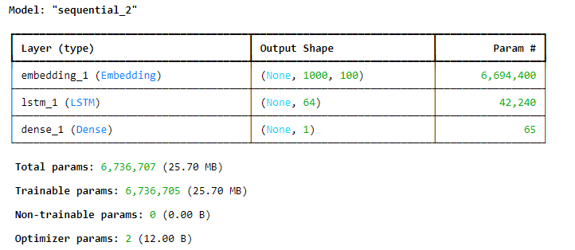
Summary of LSTM Model

Slide 9
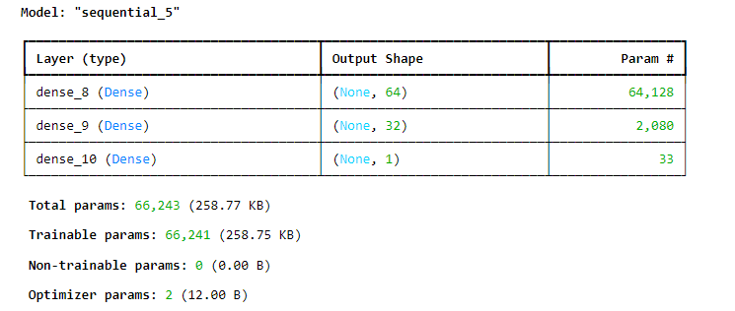
Summary of Dense Neural Network

